Slide 1
Introduction to High Level Synthesis Tool
Vitis Unified IDE 2024.1
IQBAL
PhD Researcher
with Prof. Bruno
Notes:
An HLS component is synthesized from a C or C++ function into RTL code for implementation in the programmable logic (PL) region of a SoC , MPSoC, or FPGA device.
The HLS component can be used to develop and export:
An IP to be integrated into hardware designs, and used with provided software drivers for application development in embedded systems
Kernels for use in the application acceleration development flow for use with AI Engine graph applications in heterogeneous compute systems, or for use in Data Center acceleration

Slide 2
Objectives
After completing this module, you will be able to:
Describe how HLS Components are created and maintained in Vitis Unified IDE
State various steps involved in using HLS Component creation wizard
Distinguish between the role of top-level module in test bench and design to be synthesized
List various verifications which can be done in Vitis HLS
Using Code Analyzer to identify potential for parallelism
Design Analysis using
Schedule Viewer, Dataflow viewer, Function Call graph and Timeline Trace View

Slide 3
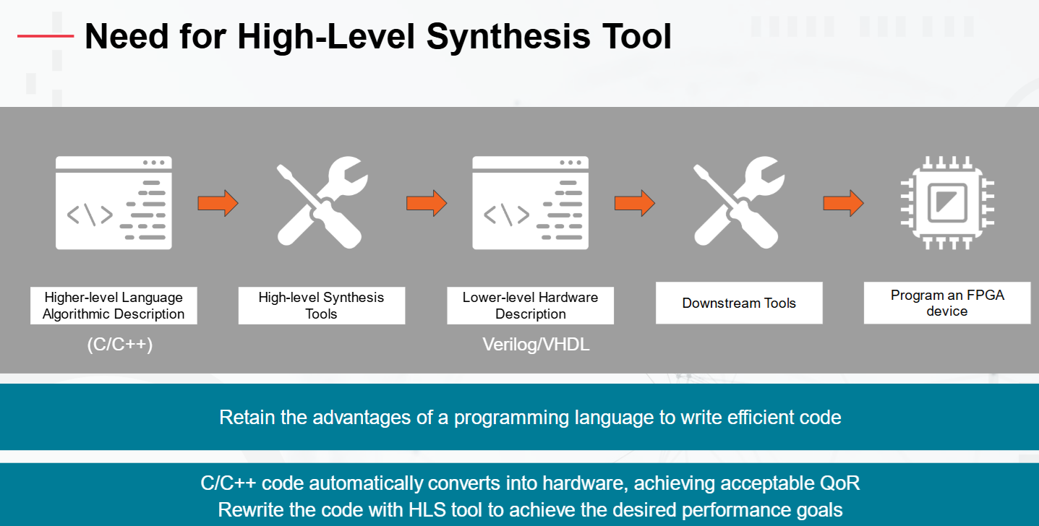
Why-HLS

Slide 4
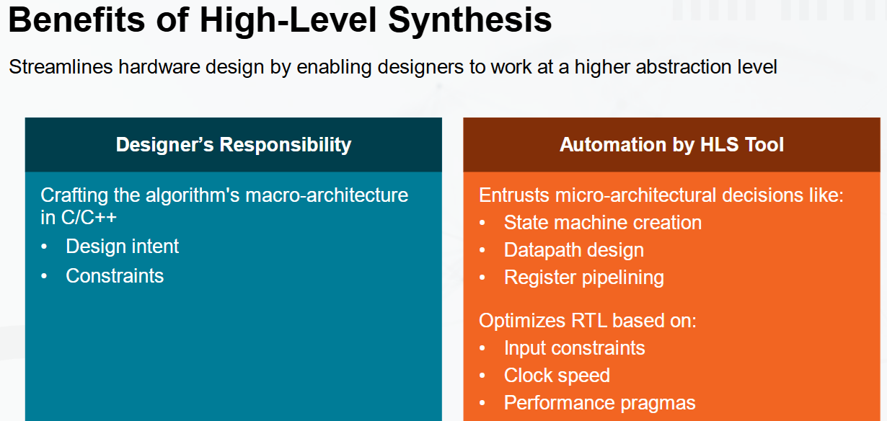
Advantages

Slide 5
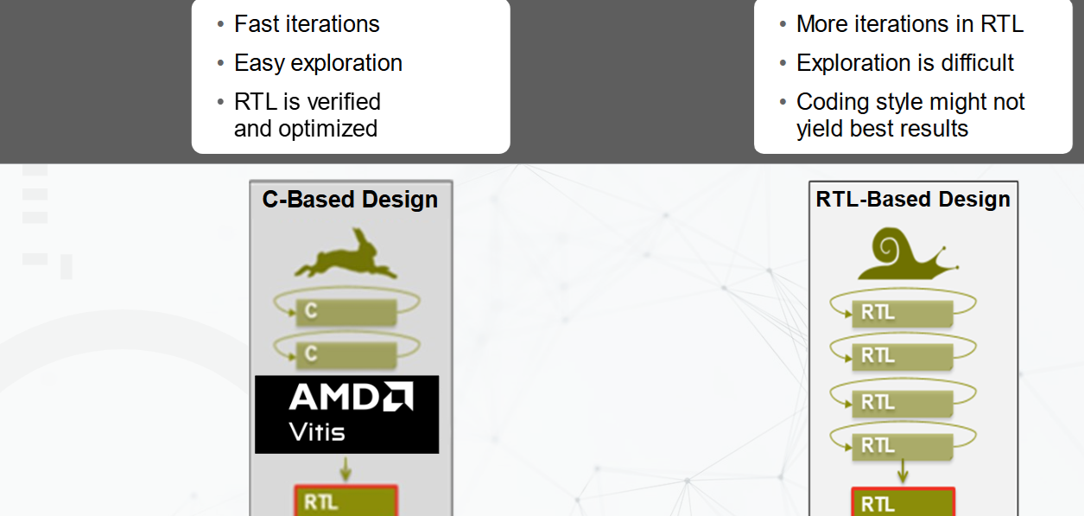
Advantages

Slide 6
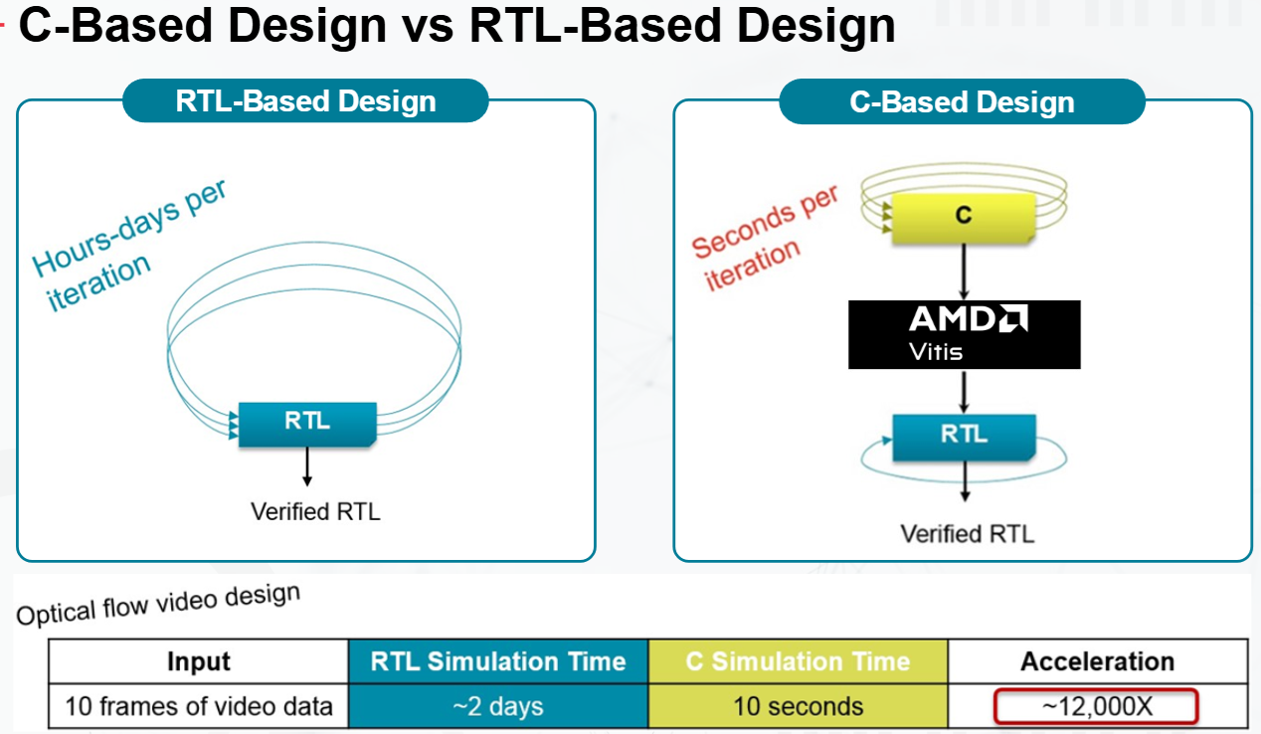
Advantages

Slide 7
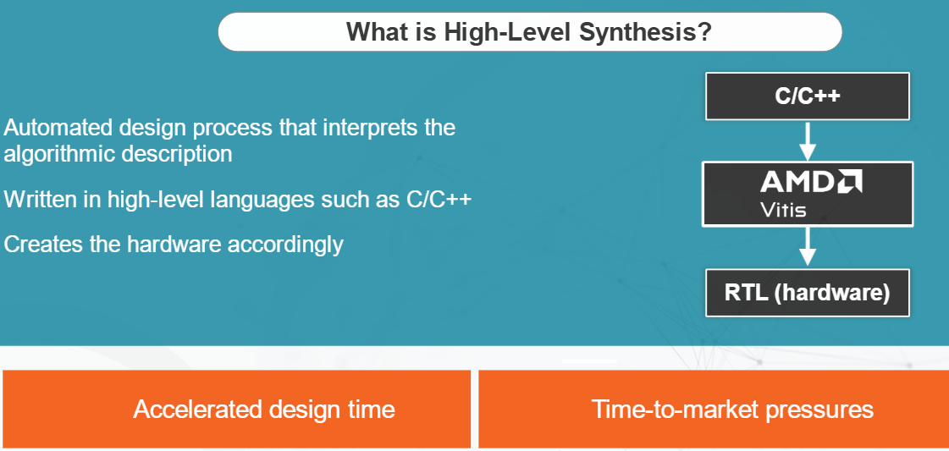
Advantages

Slide 8
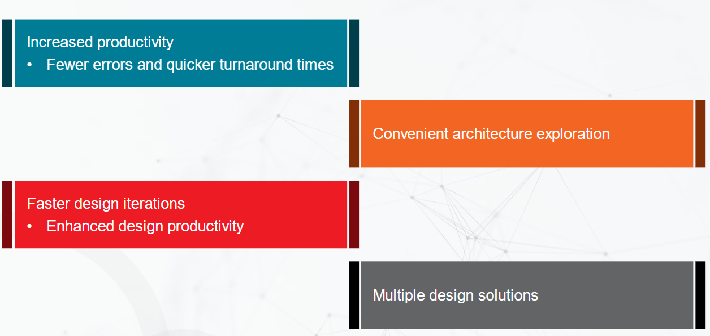
Advantages

Slide 9
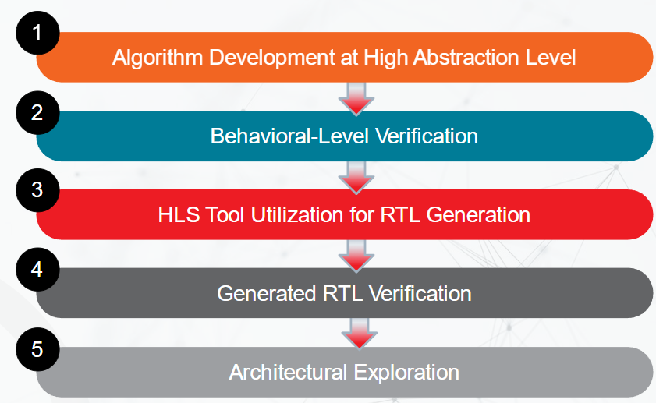
HLS Flow

Slide 10
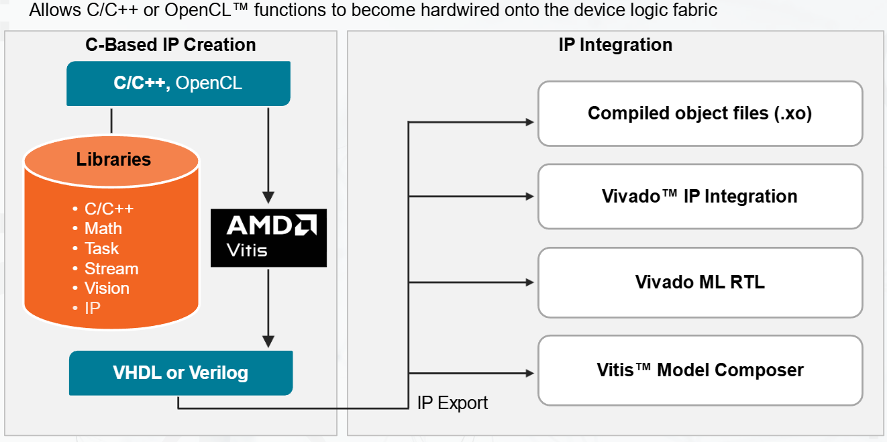
Vitis Unified IDE for HLS

Slide 11
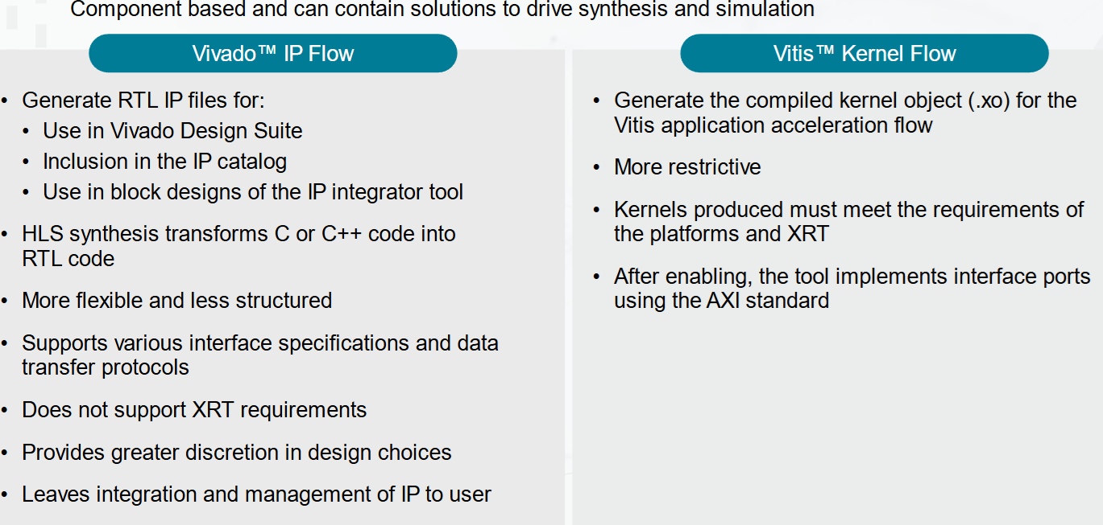
Vitis Unified IDE for HLS

Slide 12
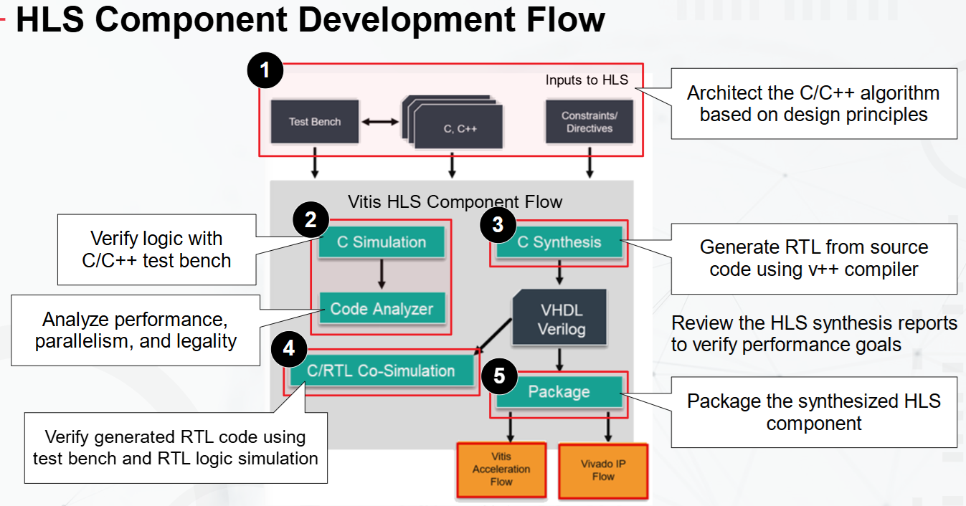
Building an HLS Component
Notes:
The following are the steps for the development of the C++ function.
Architect the C/C++ algorithm based on Design Principles
Verify the logic of the source code with a C test bench (C-Simulation)
Analyze the parallelism and performance of the design (Code Analyzer)
Generate the RTL from the source code (C-Synthesis)
Verify the generated RTL module with the C test bench and RTL logic simulation (C/RTL Co-Simulation)
Review and analyze the HLS synthesis reports and co-simulation reports (Analyze)
Repeat previous steps until performance goals are met

Slide 13
Vitis Unified IDE 2024.1
Notes:
An HLS component is synthesized from a C or C++ function into RTL code for implementation in the programmable logic (PL) region of a SoC , MPSoC, or FPGA device.
The HLS component can be used to develop and export:
An IP to be integrated into hardware designs, and used with provided software drivers for application development in embedded systems
Kernels for use in the application acceleration development flow for use with AI Engine graph applications in heterogeneous compute systems, or for use in Data Center acceleration

Slide 14
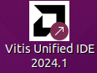
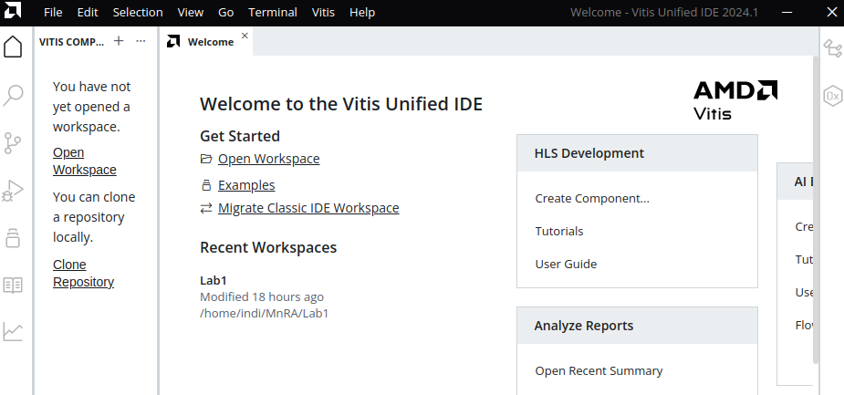
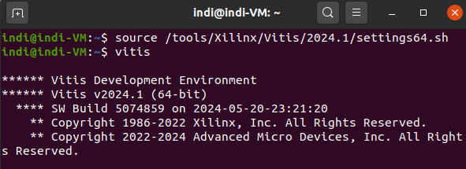
Invoke Vitis Unified IDE
From Desktop Icon/ Shortcut
Click on Desktop shortcut/ icon
-Vitis Unified IDE 2024.1
Vitis Unified IDE Welcome Window
From Terminal
[host]$ source /tools/Xilinx/Vitis/2024.1/settings64.sh
[host]$ vitis
Notes:
Vitis Unified Can be invoked from terminal or Desktop shortcut/ Icon.

Slide 15
Welcome Window
Under HLS Development, you have the following options.
Create Component
Tutorials:
Under Get Started
Open Workspace:
Recent Workspaces:
Notes:
Under HLS Development, you have the following options.
Create Component: Launches the wizard to create a new component.
Tutorials: Opens a web browser pointing to the Vitis-HLS-Introductory-Examples on GitHub. See Tutorials and Examples.
Under Get Started
Open Workspace: Opening a workspace makes it easier to find the tool-generated logs and scripts at single location.
Recent Workspaces: You can load one of the prior workspaces listed under Recent Workspaces.

Slide 16
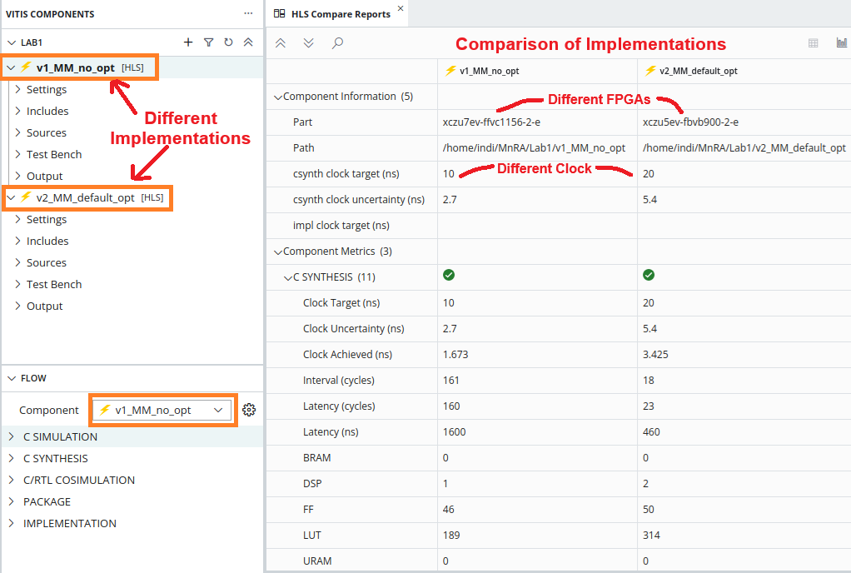
Vitis HLS Component and Different Implementations
Vitis HLS is Component based
A Component specifies the source code which will be synthesized
Each Component is based on one set of source code
A Component can have different Implementations of the same source code
Different implementations are created by cloning the Component
Different implementations can have different clock frequencies, target technologies, synthesis directives
Each Implementations is stored in its own folder within the Workspace directory.
All implementations share same source code. Changes in source code can affect all implementations

Slide 17
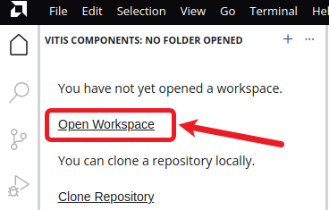
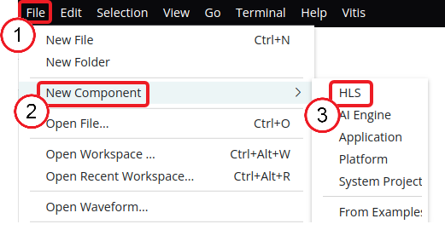
Create an HLS Component
Set the workspace
Click the open workspace link.
Browse to your desired location e.g.
/home/indi/MnRA/Lab1
The tool relaunches using the new workspace.
Create the HLS component
From File menu click New Component
Select HLS from the options to create the HLS component.

Slide 18
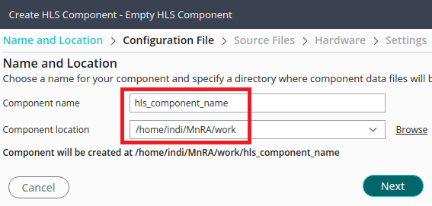
HLS Component Wizard – Name and Location
Enter the Component name in the field. This sets:
Name of the HLS component
Associated directories
Files are populated within this directory.
Component location field is automatically set to the workspace location

Slide 19
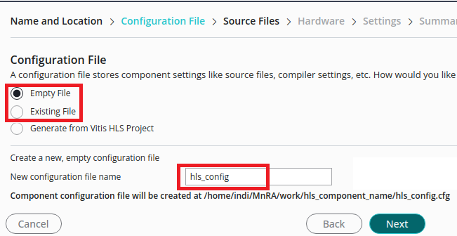
HLS Component Wizard – Configuration File
The HLS component configuration file contains:
Commands & directives used for:
Synthesis, Simulation, and export of the component.
Three ways to add a configuration file to your component:
Empty File: New empty configuration file to be populated after component creation.
Existing File: Specifies the use of an existing configuration file.
Generate from Vitis HLS Project: This option generates a new config file from an existing Vitis HLS project hls.app file

Slide 20
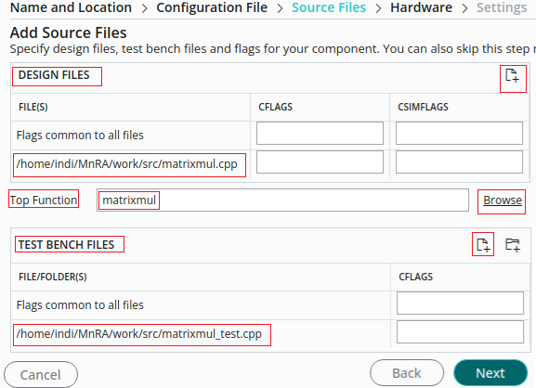
HLS Component Wizard – Source & Testbench Files
Add primary source file/s for the design.
No need to include headers (.h) if they reside in the same directory
Add Top Function which is to be synthesized as the top-level function for the HLS component.
Any functions called by the top-function will also be synthesized into RTL.
And all files referenced by the test bench
The RTL simulation is executed in a different directory (So the original results are not over-written)
Vitis HLS re-use these to verify the RTL in co- simulation
Add CFLAGS and CSIMFLAGS
to direct compilation and simulation.
Add location of any (header) files not in the same directory as the source: -I../include

Slide 21
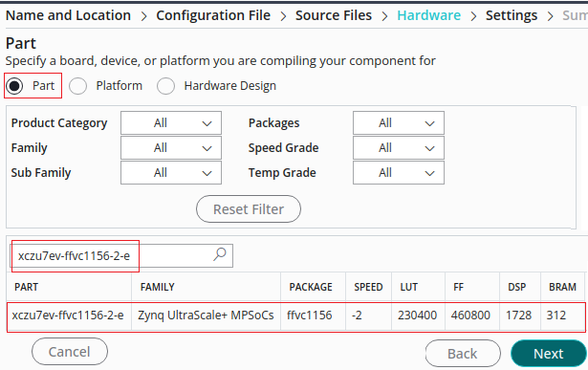
HLS Component Wizard – Hardware Technology
Select the Part or Platform for HLS component.
If Platform is selected, the Vitis unfied IDE extracts the part from the specified platform and adds part= to your configuration file.

Slide 22
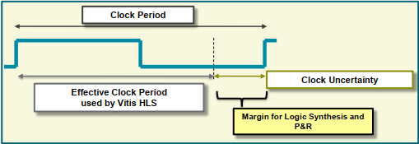
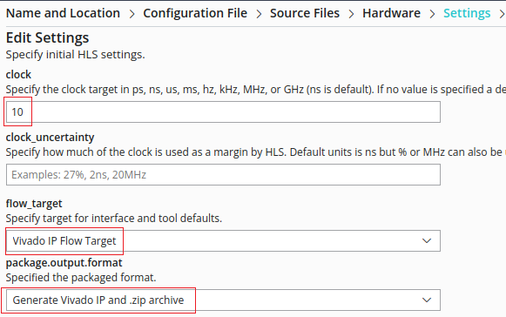
HLS Component Wizard - Settings: Clock
Specify a clock period/ frequency for the design, and clock uncertainty.
The clock uncertainty is subtracted from the clock to provide an “effective clock period”
Vitis HLS uses the “effective clock period” for Synthesis.
Provides users defined margin for downstream RTL synthesis & P&R.
The default clock is 10 ns (or 100 MHz), and uncertainty of 27%.
Specify the target flow either as Vivado IP Flow target or a Vitis kernel.
The default flow_target is the Vivado IP flow.
Specify the package output format for the tool to generate when packaging the design.
The default format is Vivado IP, which generates a .zip file to be added to your IP catalog.

Slide 23
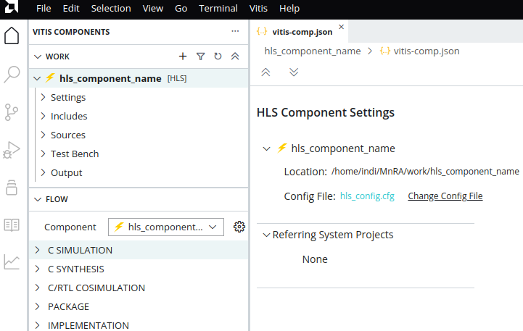
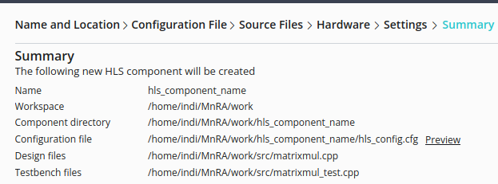

HLS Component Wizard – Component Created
The Summary page reflects the choices you have made on the prior pages.
Review the summary and select Finish to create the HLS component, or select Back to return to earlier pages and change your selections.
Once HLS component is created the vitis-comp.json file is opened in the central editor window
HLS component becomes active in the Flow Navigator as shown below.

Slide 24
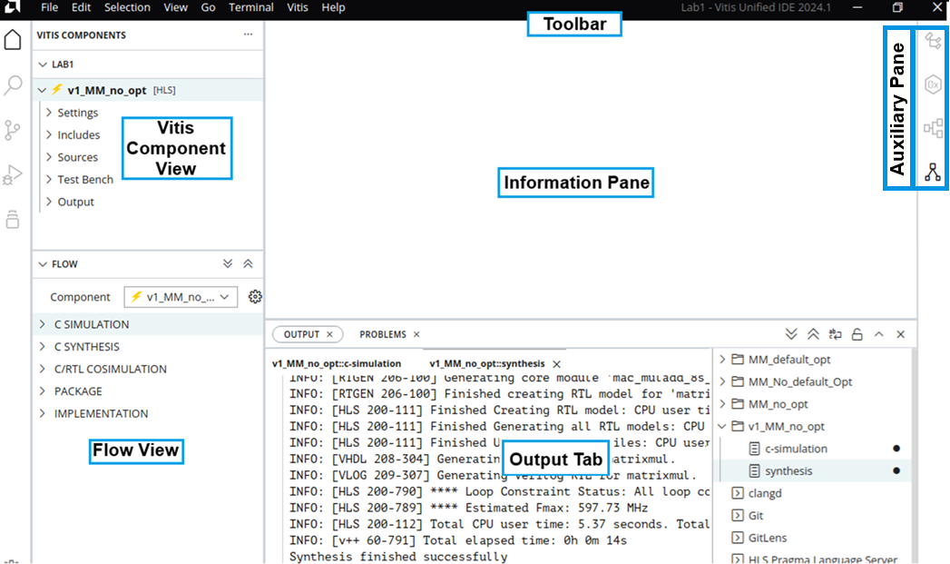
Vitis Unified IDE GUI
The Vitis GUI consists of various panes for proceeding with HLS development:
Vitis Components view:
Help navigate through the component hierarchy.
Expandable sub-folders organize various components, such as source files and test benches.
Information pane:
Displays report summaries
Shows the contents of open files.
Output view:
Displays the output when the Vitis is running synthesis or simulation.
Flow view:
Provides access to commands and processes to take through;
simulation, synthesis, and exported output.

Slide 25
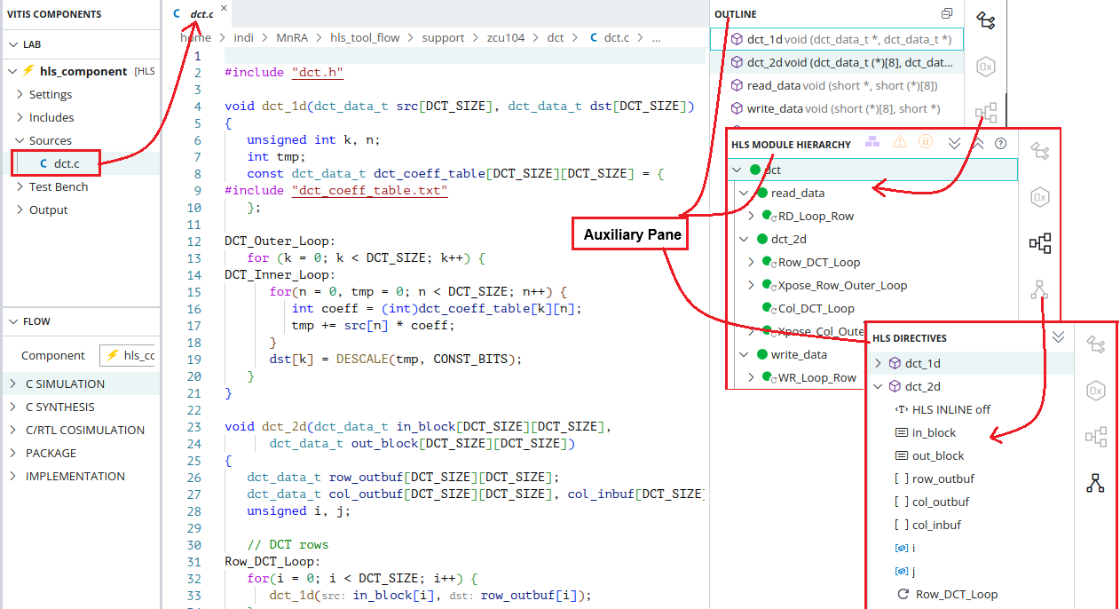
Auxiliary Pane
The Auxiliary pane is context sensitive with respect to the information pane
Outline: Displays the processes or functions/ sub-functions. Clicking on each highlight the code in Information pan.
HLS Module Hierarchy: It displays detailed hierarchy along with sub-functions and loops nests.
HLS Directive: It displays elements in the code which can have directives specified on them

Slide 26
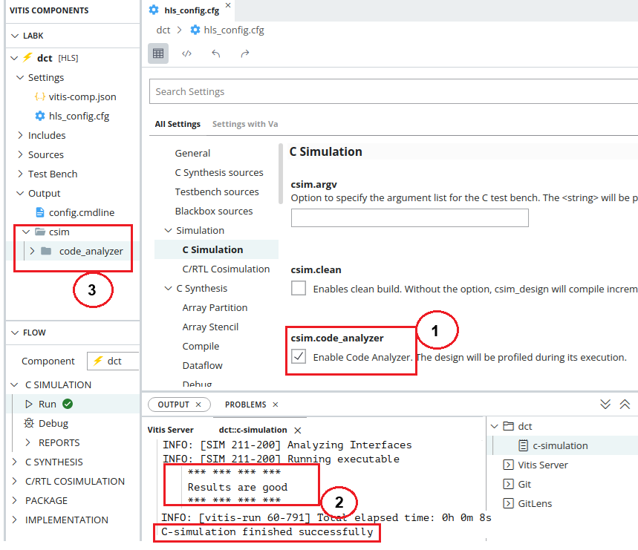
C-Simulation
Run C Simulation
Enable Code analyzer under Simulation in hls_config.cfg file
Click Run under C Simulation in Flow View
Output Tab will show run time information
Examine for failed constraints
A “CSIM” directory is created
Observe code_analyzer directory under csim.

Slide 27
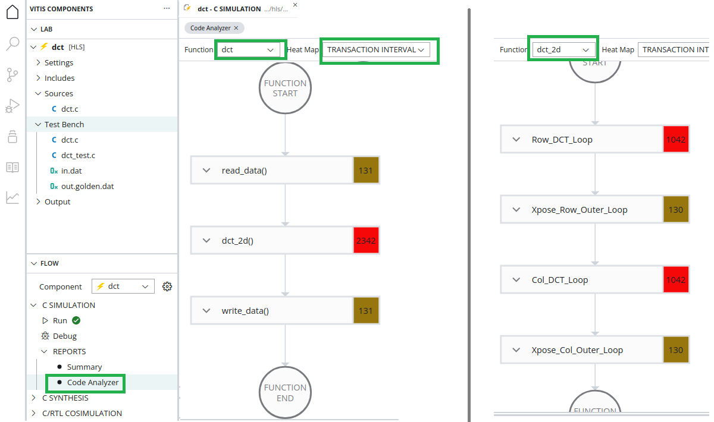
Code Analyzer
In HLS code changes are often required to improve the macro architecture of the design.
Vitis HLS Code Analyzer let you visualize the potential for task level parallelism and understand the architectural changes needed to optimize performance.
Nodes: Processes i.e. functions/ sub-functions and loops are reprented by nodes.
Edges: Data dependencies among process are represented as edges (channels)

Slide 28
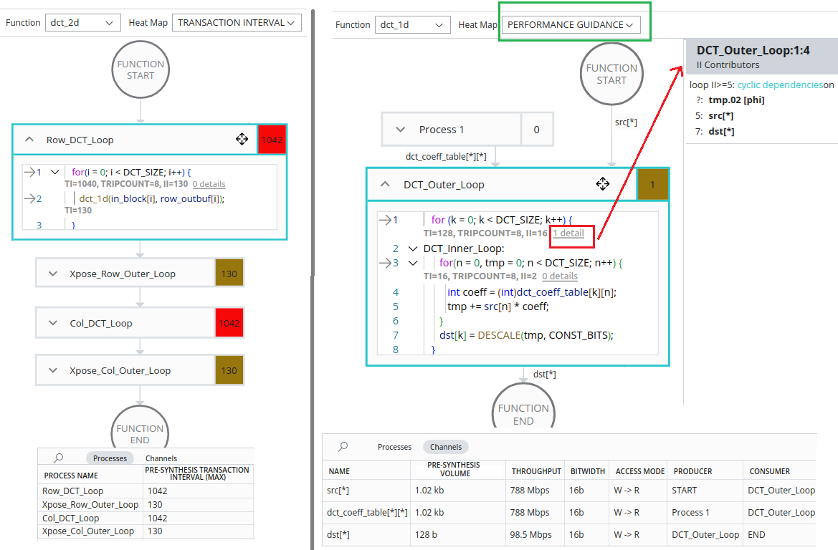
Code Analyzer
Analyze the design prior to synthesis, to estimate
the transaction interval
throughput of the channel.
Identify any major performance blockers in source code
cyclic dependencies
memory port contention.

Slide 29
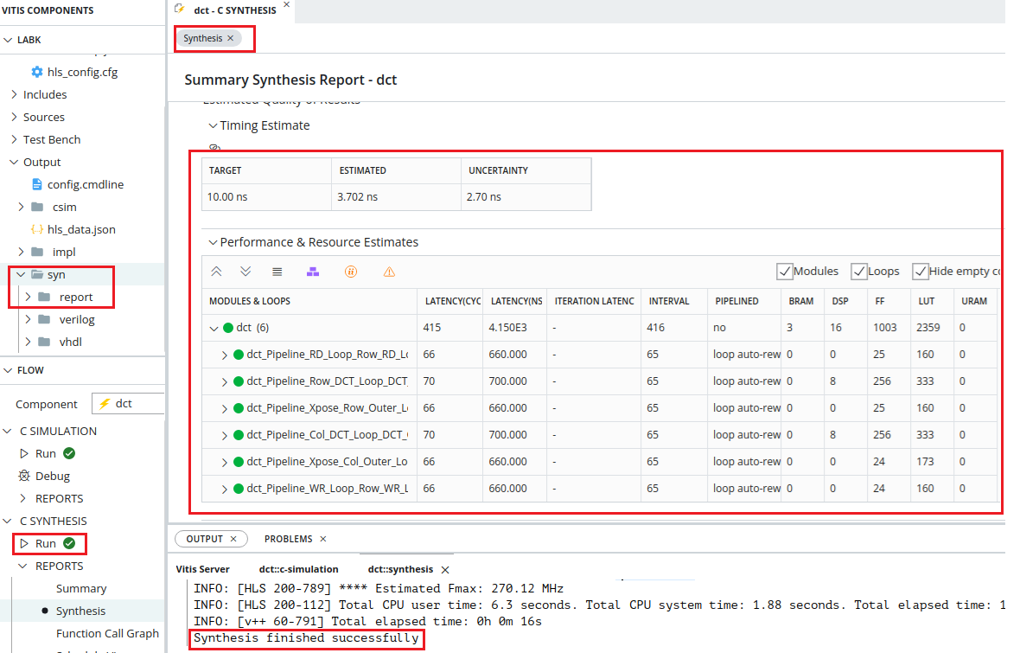
Synthesis
Run C Synthesis
Output tab will show run time information
Examine for failed constraints
A “syn” directory is created
Note Verilog & VHDL RTL
Synthesis Report opens automatically

Slide 30
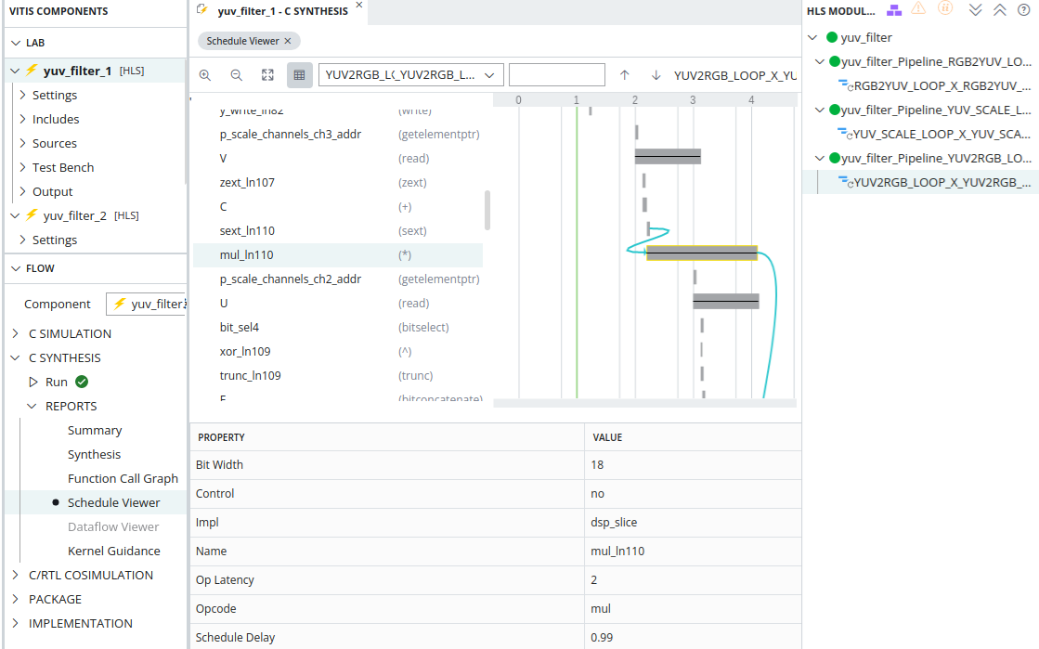
Schedule Viewer
Provides a detailed view of the synthesized RTL
Shows operations & control step and the clock cycle that it executes in.
It helps you to identify:
loop dependencies
timing violations
data dependencies.
It also shows the properties of operations and control steps.

Slide 31
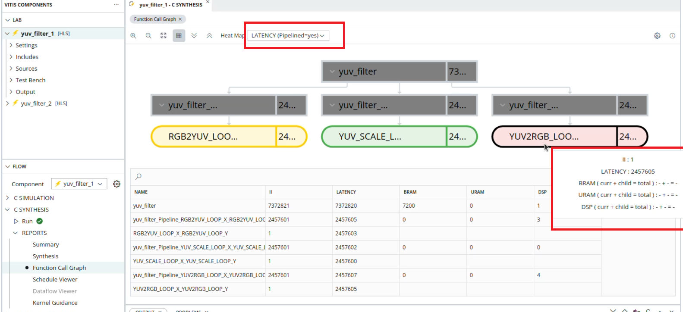
Function Call Graph
Shows the throughput in terms of latency and II.
Helps identify bottlenecks in the design and the critical path to improve throughput.
It can also show the paths through the design where throughput might be imbalanced leading to FIFO stalls and/or deadlock.
The heat map feature highlights several metrics of interest; II Latency, Stalling Time Percentage.
The heat map uses color coding to highlight problematic modules with a color scale of red to green

Slide 32
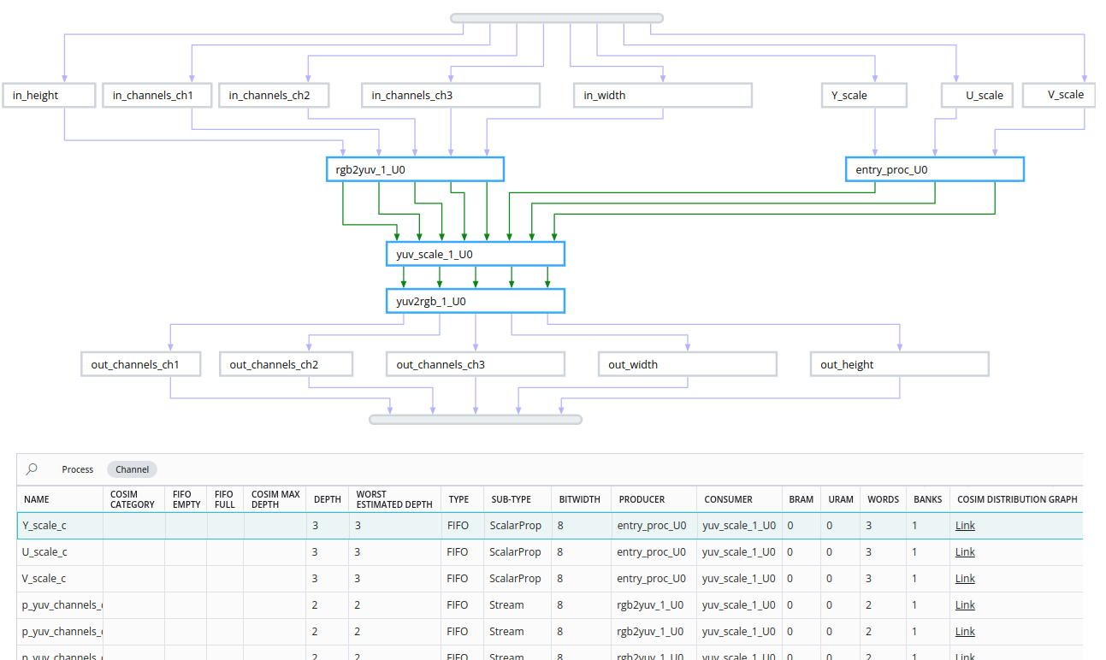
Dataflow Viewer
lets you see the dataflow structure inferred by the tool.
inspect the channels (FIFO/PIPO)
examine the effect of channel depth on performance.

Slide 33
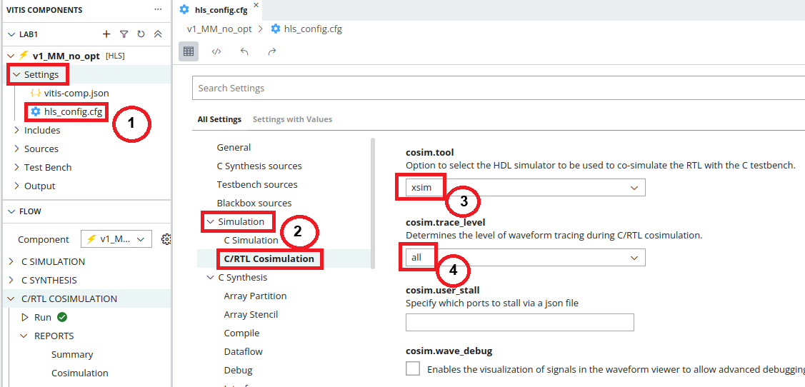
C/RTL Co-simulation
Co-simulation or simulation verification Compares the behaviour of the software (C/C++ code) with the behaviour of the RTL generated.
The hope is that identical results are produced.
Select the RTL
Verilog and VHDL require the appropriate simulator
Select the desired simulator
Options
Can output trace file (VCD format)
Optimize the C compilation & specify test bench linker flags
Enables waveform visualization of all processes in the RTL simulation.

Slide 34
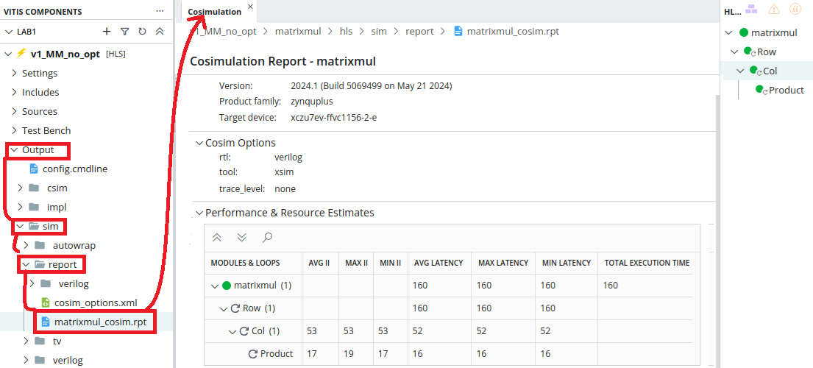
C/RTL Co-Simulation - Report
Simulation output is shown in the output tab
Expect the same test bench response
Sim Directory
Will contain a sub-directory for each RTL which is verified
Report
A report is created and opened automatically
Output files will be created in a “sim” directory

Slide 35
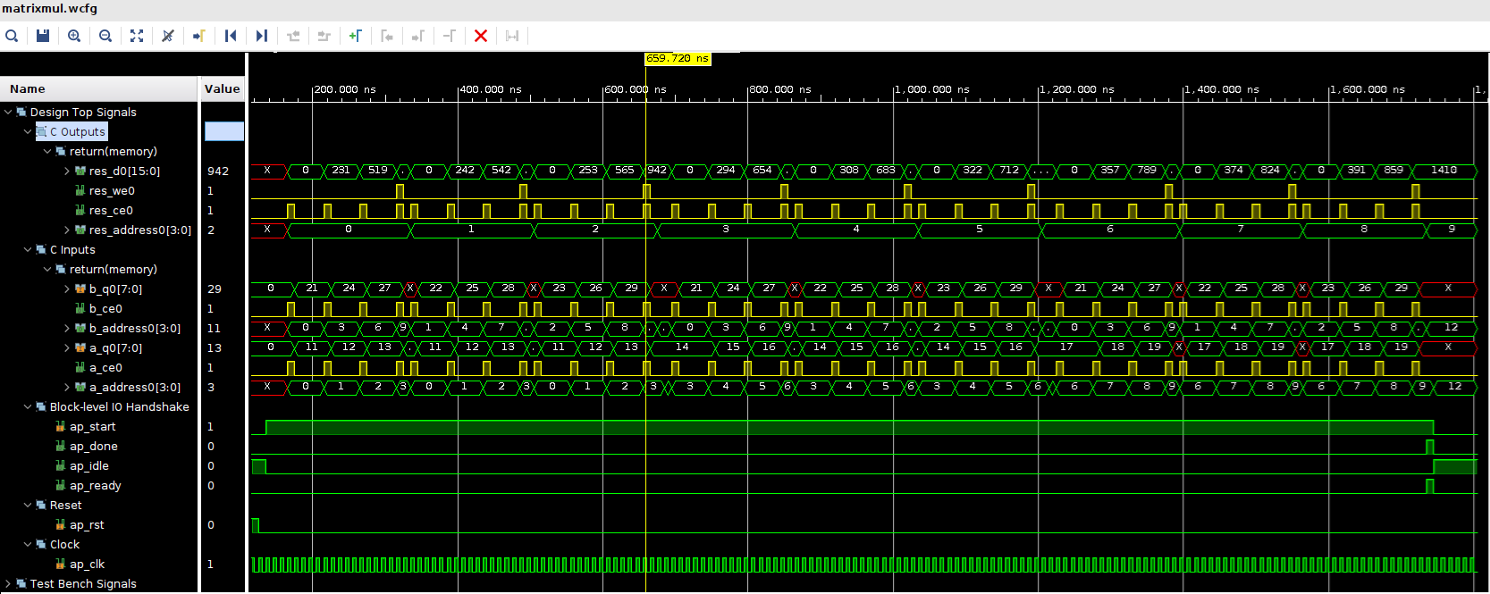
Wave Viewer
To view waveform enable the following in the Config File:
Under tool select xsim as the RTL simulator, or set cosim.tool=xsim in the config file
Under trace_level select port or all, or set cosim.trace_level=port in the config file
Vivado simulator GUI opens and displays all the processes in the RTL design

Slide 36
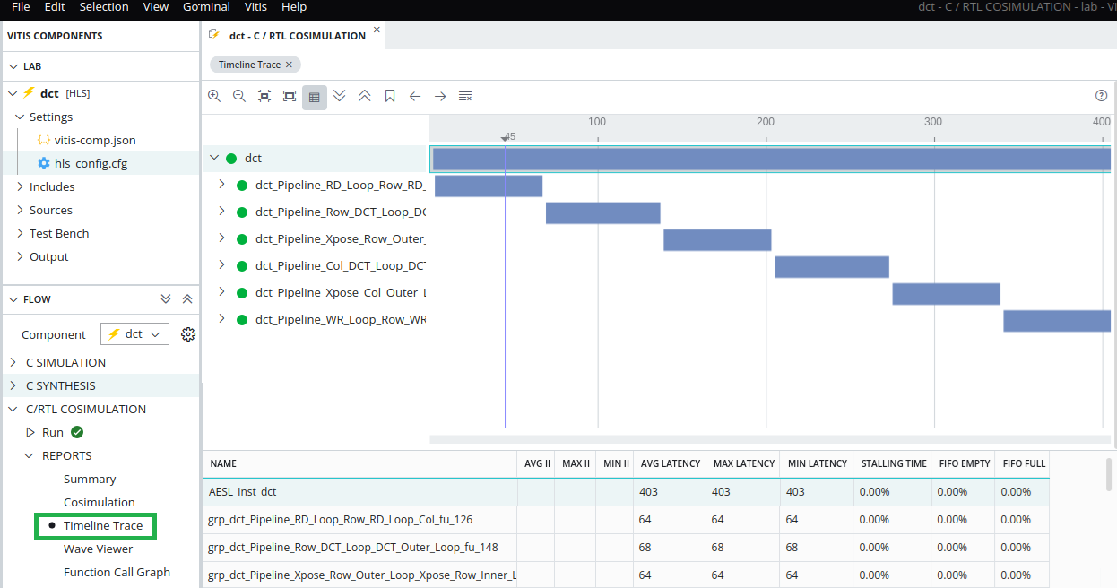
Timeline Trace Viewer
It is available after C/RTL Co-Simulation and displays:
It Shows:
Runtime profile of the functions of design
Behavior of dataflow regions after Co-simulation
Starting and ending of functions
FIFO and PIPO channel stall states with Full and Empty markers

Slide 37
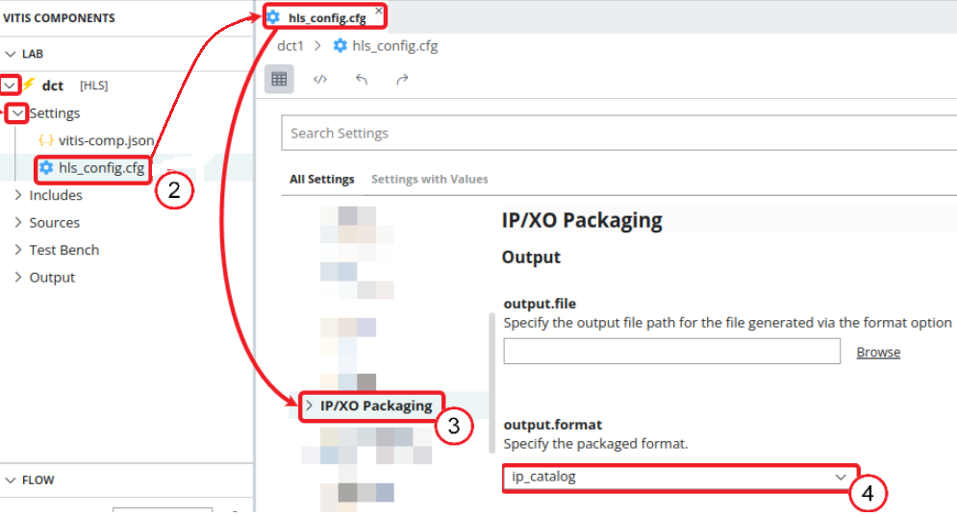
Packaging the RTL Design
The final step is to package the RTL design into a form that can be used by other tools in the design flow.
Click the Package command in the Flow Navigator to export the RTL as a Vivado IP, Vitis kernel.

Slide 38
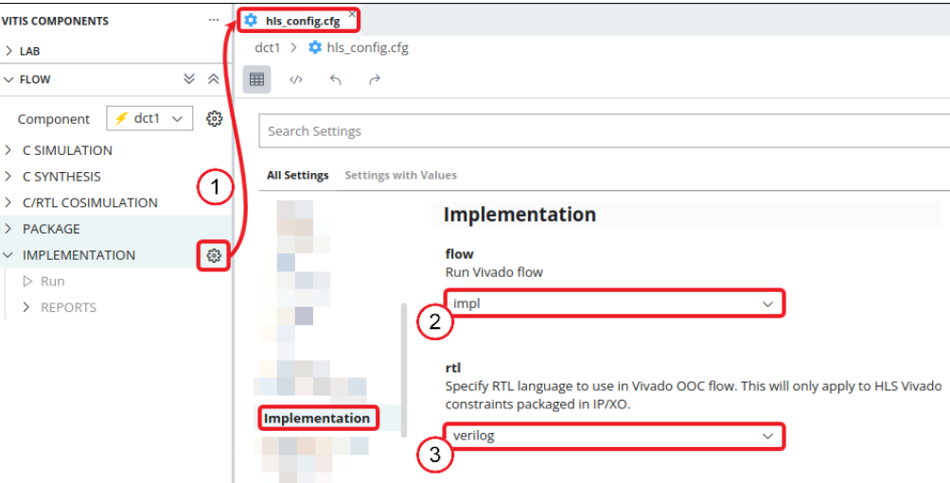
Implementation
This will perform Vivado synthesis and implementation on the generated IP.
evaluate that the RTL will meet its estimated timing and area goals
Implementation report is displayed in the Information pane.
The final timing of the implemented design has been achieved.
Look for the "Timing met" message in the Output tab and under the Final Timing report section.
The exported IP is available in the Output > impl > ip folder in the Vitis Components window.

Slide 39
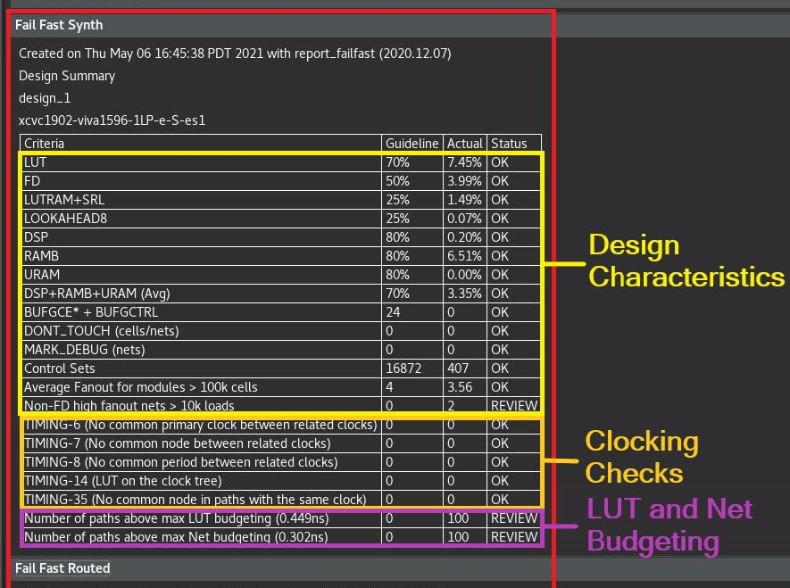
Implementation - Fail Fast
Fail fast report guides your investigation into specific issues encountered by the tool.
look into anything with the Status of REVIEW to improve the implementation and timing closure.
Different sections of the fail fast report include:
Design Characteristics:
Designs with one or more REVIEW checks are feasible but are difficult to implement.
Clocking Checks:
These checks are critical and must be addressed.
LUT and Net Budgeting:
predicts which logic paths are unlikely to meet timing after placement.

Slide 40
HLS Component Development Using the Command Line
The Vitis Unified IDE uses the v++ and vitis-run commands to compile and run the various components of a design:
The v++ compiler command in HLS component mode (v++ -c --mode hls) builds/ Synthesize an HLS component.
The vitis-run --mode hls command runs process steps, such as C simulation, C/RTL cosimulation, implementation, and export
The following are the HLS component development steps along with the corresponding commands:
Run C simulation using the vitis-run --mode hls --csim command.
Run C synthesis using the v++ -c --mode hls command.
Run C/RTL cosimulation using the vitis-run --mode hls --cosim command.
Run implementation using the vitis-run --mode hls --impl command.
Export the RTL output as IP/XO using the vitis-run --mode hls –package command.

Slide 41
Lab-1
Creating an HLS Components in Vitis Unified IDE

Slide 42
Objectives
After completing this lab, you will be able to:
Create an HLS Component in Vitis Unified IDE
Run C-simulation
Use Code Analyzer
Synthesize and implement the design using the default options
Use Analysis tools to see what is going on under the hood
Understand and analyze the generated output

Slide 43
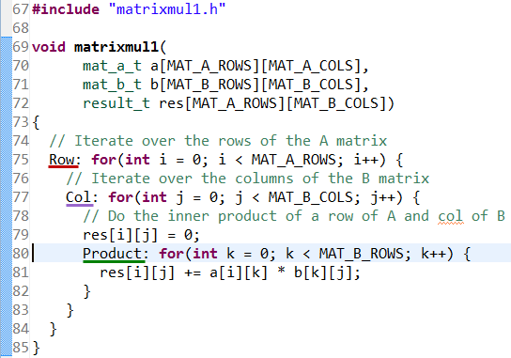
The Design
This lab uses a simple matrix multiplication example to walk you through the Vitis HLS Component creation and analysis steps.
The design consists of three nested loops.
The Product loop is the inner most loop performing the actual elements product.
The Col loop is the outer-loop which feeds next column element data with the passed row element data to the Product loop.
Finally, Row is the outer-most loop.
The res[i][j]=0 (line 79) resets the result every time a new row element is passed and new column element is used

Slide 44
Procedure
Create a Workspace after starting Vitis Unified IDE
Create an HLS Component using component creation Wizerd.
Use the source code located /Lab_1/Source_Codes/Lab1/src.
Run C simulation and Code analyzer to understand the design behavior
Synthesize the design
Analyze the generated output using the Analysis tools
Run C/RTL cosimulation to perform RTL simulation
View simulation results in Vivado to understand the IO protocol
Export RTL and run the implementation

Slide 45
Summary
In this lab, you completed the major steps of the high-level synthesis design flow using Vitis Unified IDE.
You created a Component, added source files, synthesized the design, simulated the design, and implemented the design.
You also learned that how to use the Analysis tools to understand the scheduling.

Slide 46
Task-1
Image Processing Task

Slide 47
Procedure
Use the source code located /Lab_1/Source_Codes/Task1/src to create a new HLS Component.
Image processing task requires to read a .bmp image, extract the pixels data and dimensions (height, width, #channels)
To facilitate this you are provided BMPProcessor.h containing the necessary functions.
Run C simulation and understand the behavior of imNegation()
See how main() works
Check the output image
Synthesize the design
Analyze the generated output using the Analysis tools

Slide 48
Procedure
Create and test a new function called imGrayscale() which converts an RGB image to grayscale
Try the three versions of Luma coding: https://en.wikipedia.org/wiki/Grayscale
Add an input signal to switch between the three versions
Change the input image to NightGare
Modify the code to process the DancingHouse image

Slide 49
BMPMini.h
Creating a BMPMini Object:
image::BMPMini bmp("input.bmp");
→ Loads the BMP image, reads header & pixel data.
Retrieving Image Metadata:
auto img = bmp.get();
→ Access image width, height, channels, and raw data.
Extracting Pixel Data:
bmp.getRGBChannels(R, G, B); → Extracts RGB channels.
bmp.getGrayChannel(Grey); → Extracts grayscale data.
Writing Processed Image:
bmp.writeRGB("output.bmp", R, G, B, width, height);
→ Saves RGB image.
bmp.writeGreyScale("output_gray.bmp", Grey, width, height);
→ Saves grayscale image.

Slide 50
Thanks

